Slide 1


Slide 2


Quiz Game in C Programming Language Reference: “Knowledge 360” “@Youtube”

Slide 3

Members:
Huzaifa Ali
(se211064)
Zeeshan Javed
(se211067)
Muhammad Rehan Alauddin
(se211078)
Huzaifa Khalid
(se211102)

Slide 4
Problem Statement (Quiz Game in C)
In this project we will develop a module where the user will appear in Practice round test where 6 questions and then start Challenge Round will have 20 questions if user correct 4 answer from 6 question Practice Round otherwise you can't play CHALLENGE ROUND. These questions will picked up all from internet. Each question will have 4 options. User has to choose the correct one. When he submits his answer ,all the questions will be evaluated in the similar manner and marks will be assigned to the correctly chosen answers. At the end it will display the marks that the user has secured.
So, for this project we will using Switch Statement for options, If else condition for if answer is correct then it will print correct otherwise print Wrong answer and tells correct answer, and pointer for read and write the score of quiz game.
And In this project some difficulties faced by our team members, Like:
View Score (Space between in name)
Jump in new slide (goto statement)
(toupper(getch())==Any Alphabet in uppercase and lowercase both (Like : “Y or y” etc…)
System background color ( our team don’t know color property in cmd prompt)

Slide 5
Project Description (Quiz Game in C)
In this project, a number of questions are asked, and the user is awarded a 5 Tola of gold price for each correct answer given.
In the quiz games, questions are chosen in such a way that they cover all
“ C program ” fields of a typical quiz contest.
The user’s general knowledge is tested with quiz questions regarding: “ C program ”
There are two rounds in this game, PRACTICE ROUND & CHALLENGE ROUND.
In practice round you will be asked a total of 6 questions to test your general
knowledge. You will be eligible to play the game if you can give atleast 4
right answers otherwise you can't play CHALLENGE ROUND.
Your game starts with the CHALLENGE ROUND. In this round you will be asked
total 20 questions each right answer will be awarded 5 TOLA OF GOLD!
By this way you can win upto 100 TOLA OF GOLD.
You will be given 4 options and you have to press A, B ,C or D for the right option.
You will be asked questions continuously if you keep giving the right answers.
No negative marking for wrong answers.
Shows the Highest Score or Gold prize won by a particular user.

Slide 6

Source Code With Output (Quiz Game)

Slide 7
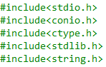
Header Files:

Slide 8
Function Declarations:

Slide 9
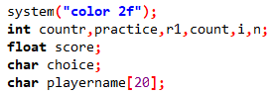
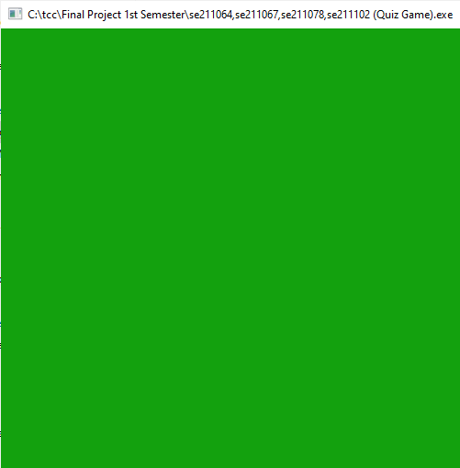
System Theme background (Green Theme Applied In This Project) and Variable Declarations:

Slide 10
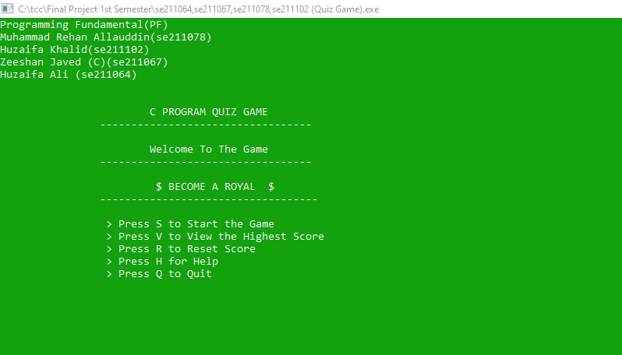
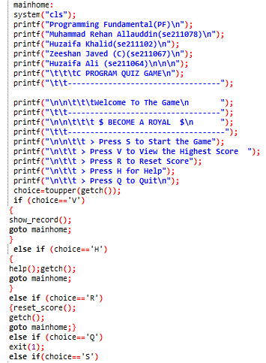
Main Home Screen:

Slide 11
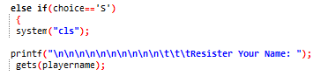
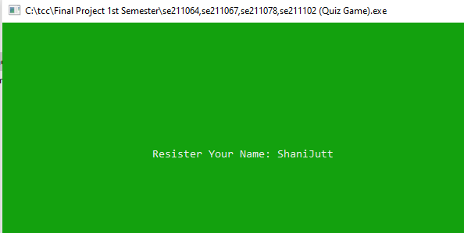
Registration Yourself In Quiz Game:
(Output)

Slide 12
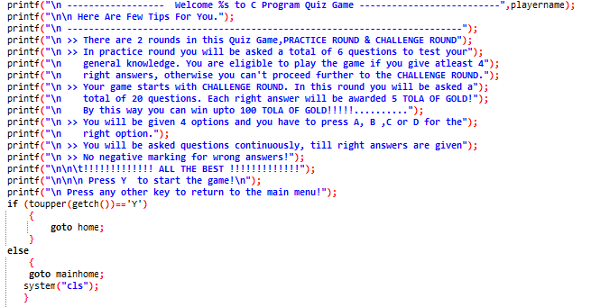
After Registration, Instructions are given which helpful for start and end Quiz game easily.

Slide 13
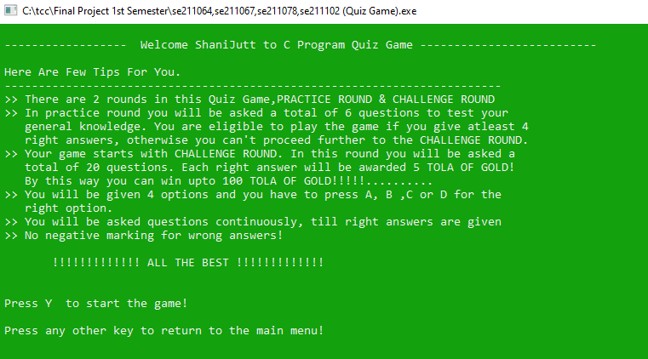
After Registration, Instructions are given which helpful for start and end Quiz game easily. (Output)

Slide 14
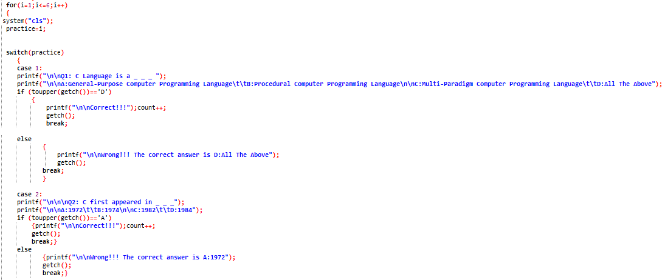
Practice Round Questions:

Slide 15
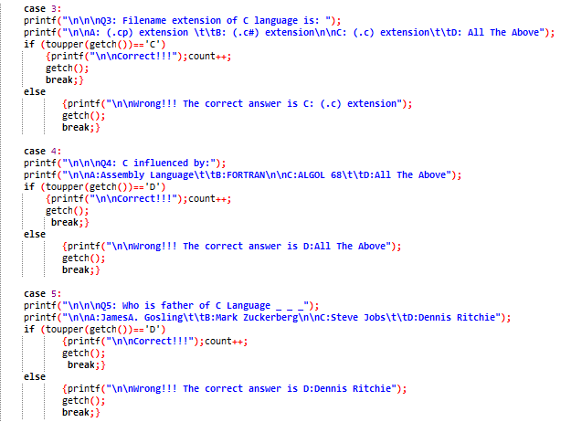

Slide 16
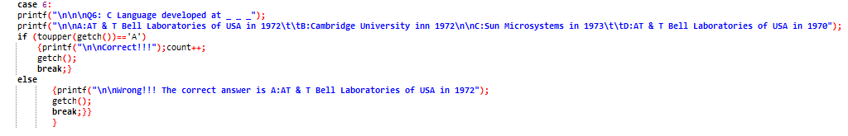
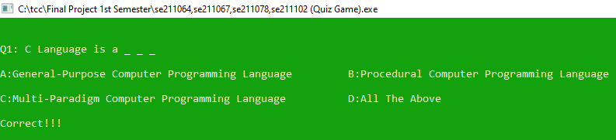
Practice Round Questions (Output)

Slide 17
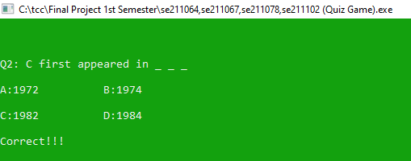
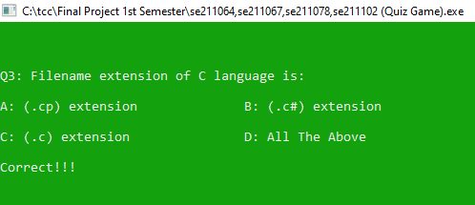
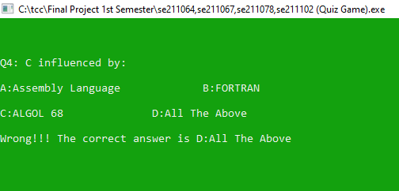

Slide 18
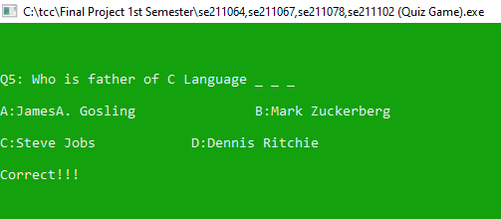
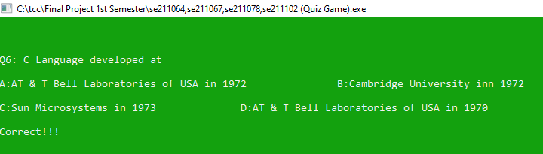
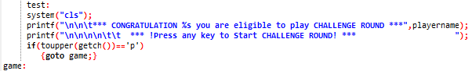
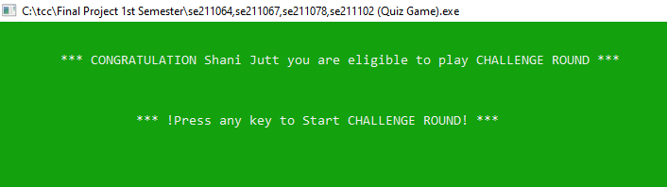
If you clear all the Practice Round questions with correct answer and only one or two wrong answers then you are eligible for the Challenge Round Otherwise not eligible for the Challenge Round.

Slide 19
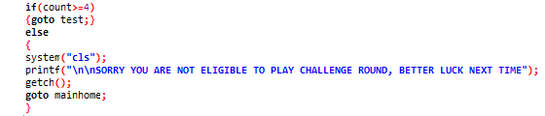
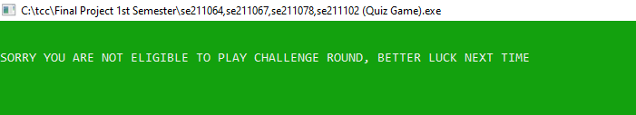
If you clear all the Practice Round questions with wrong answers and only one or two correct answer then you are not eligible for the Challenge Round.

Slide 20
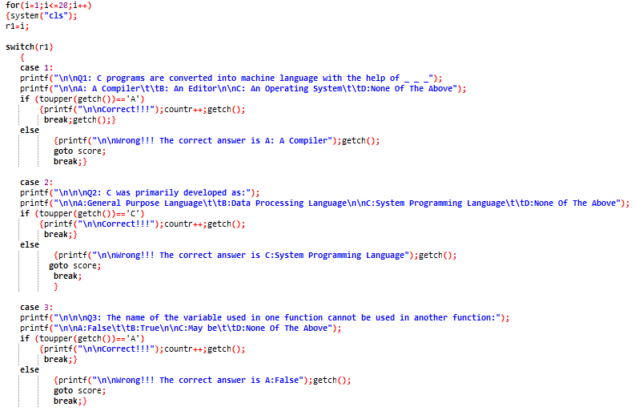
Challenge Round Questions:

Slide 21
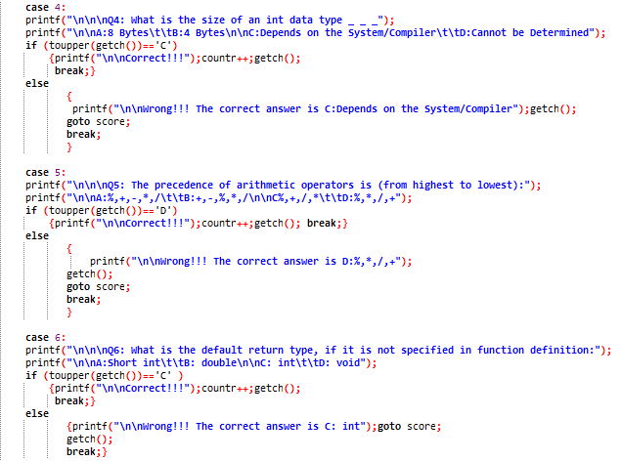

Slide 22
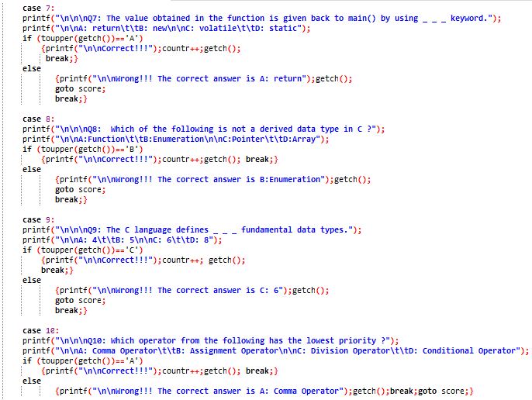

Slide 23
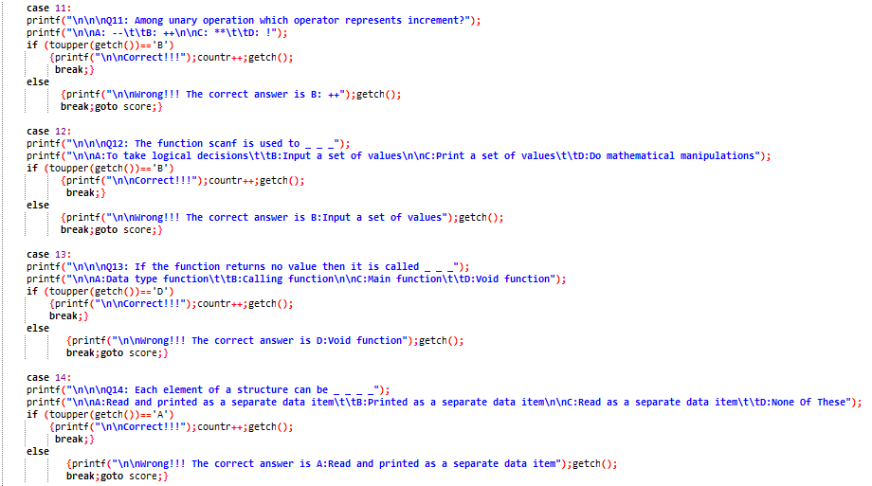

Slide 24
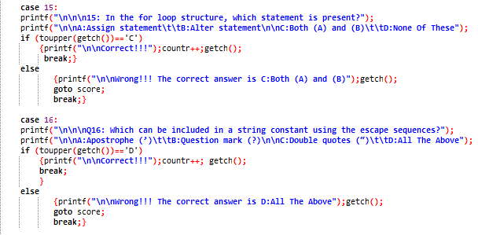

Slide 25
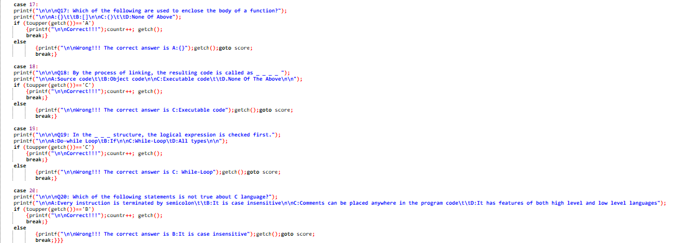

Slide 26
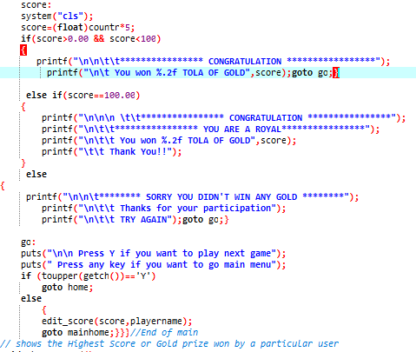
If you click wrong option of Q16 then you get 75 points or 5*15=75 Tola of Gold. And if you clear all the Challenge Round question with correct answers then you get 100 points or 5*20=100 Tola of Gold and stored score in score.txt file.

Slide 27
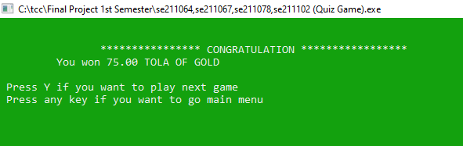
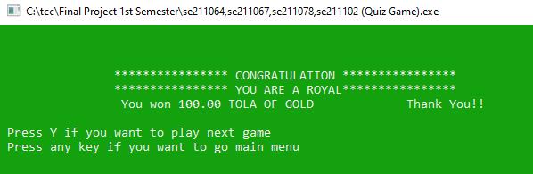
Output:

Slide 28
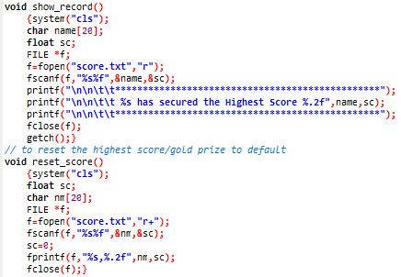
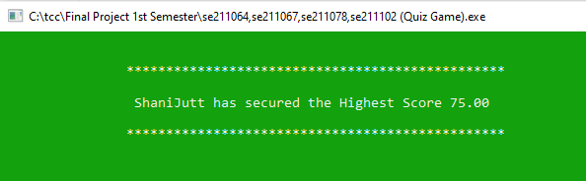
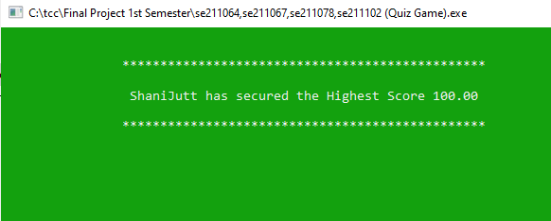
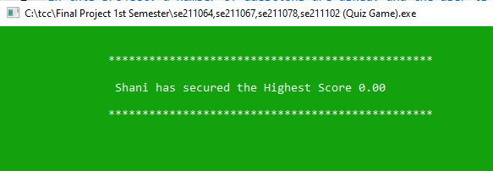
If you give space in your name then you get error like this:

Slide 29
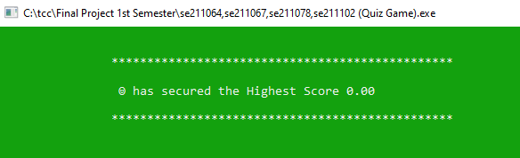
Reset Score:

Slide 30
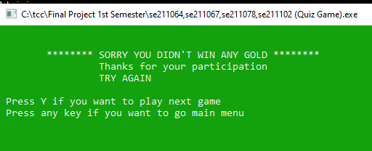
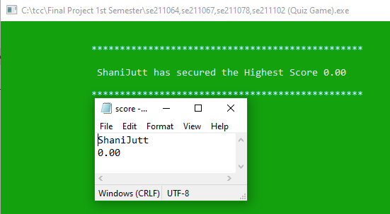
If you stuck in Q1 of Challenge Round and you give a wrong answer then your screen shows a message and stored score in score.txt file

Slide 31
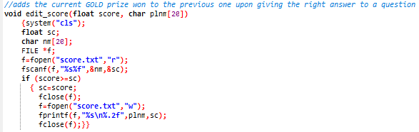
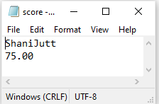
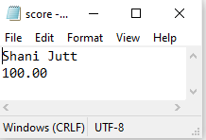
If you get lowest or highest score, so this score automatically write in score.txt file in your pc with the help of pointer function.

Slide 32
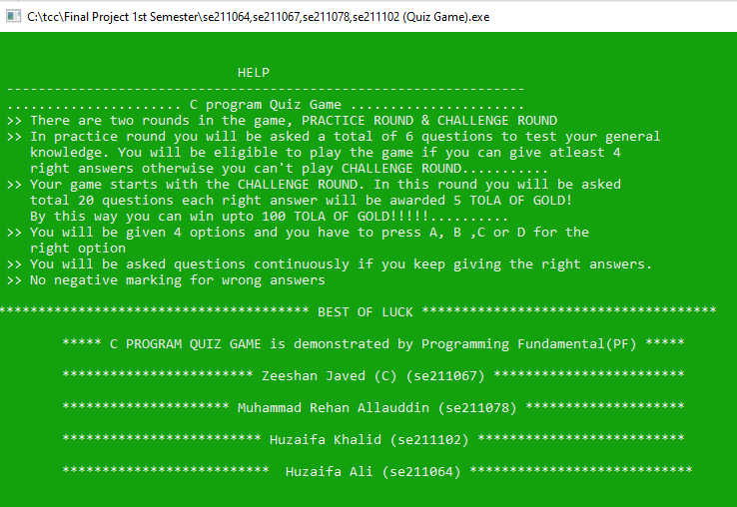
Help Desk:

Slide 33
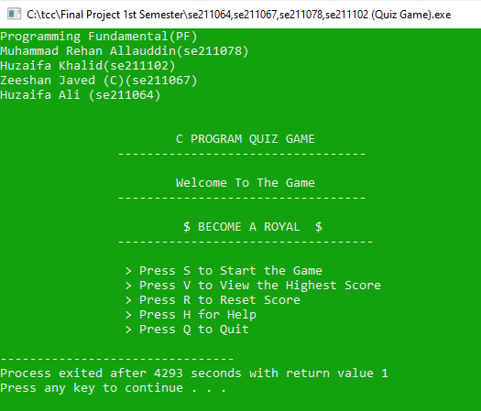
Output:
Quit Game:
If you will want no playing this game, So press Q and Program will be terminate.

Slide 34
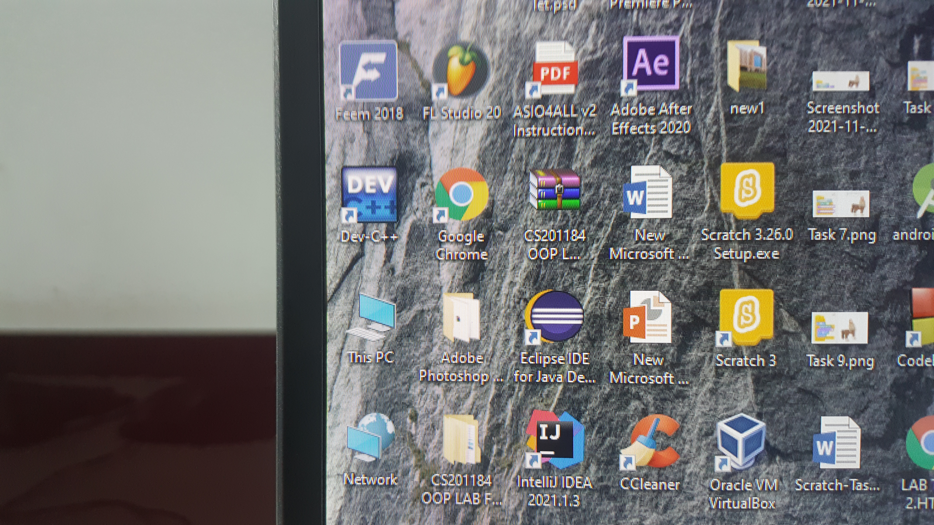
So, in this project we used only one application “Dev C++” -:The End:-

Slide 35


